Slide 1
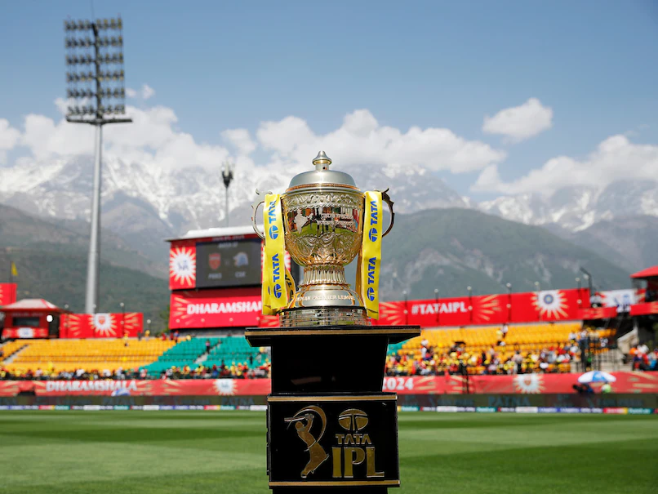
Ipl auction
SQL PROJECT

Slide 2

Indian Premier League (IPL) is a professional Twenty20 cricket league in India contested during March or April and May of every year by eight teams representing eight different cities or states in India. The league was founded by the Board of Control for Cricket in India (BCCI) in 2007.
The IPL is the most-attended cricket league in the world and in 2014 ranked sixth by average attendance among all sports leagues. In 2010, the IPL became the first sporting event in the world to be broadcast live on YouTube. The brand value of IPL in 2020 was estimated to be around ₹475 billion (US$6.7 billion), according to Duff & Phelps.

Slide 3
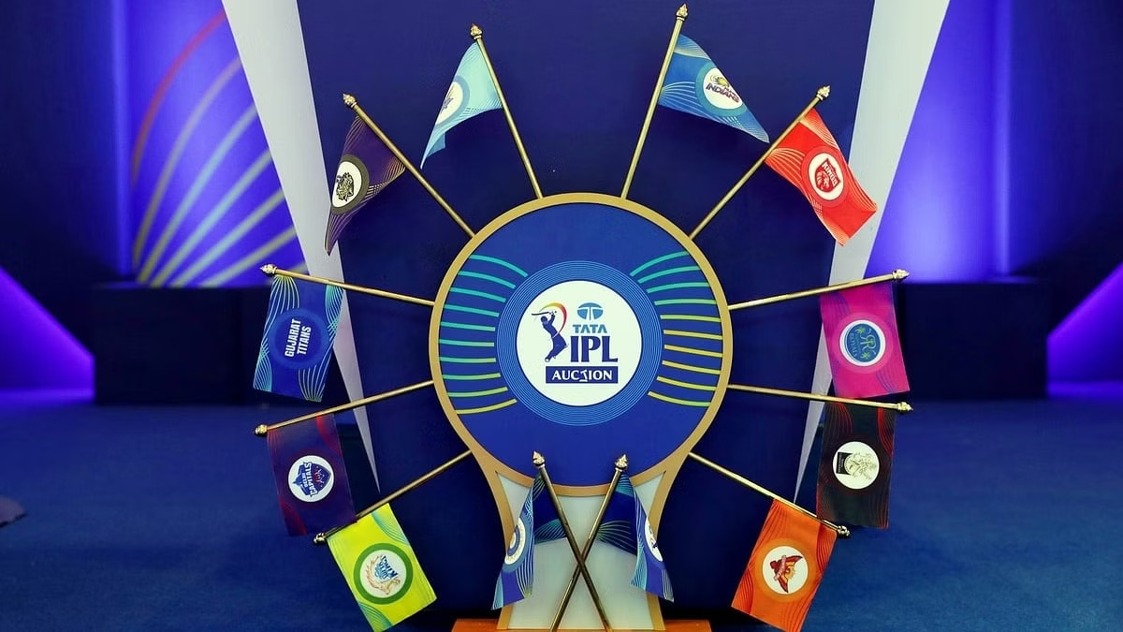
IPL AUCTION
Mumbai Indians have won five titles. Chennai Super Kings have won four titles and Kolkata Knight Riders have won two titles, Sunrisers Hyderabad, Gujarat Titans and Rajasthan Royals, apart from former team Deccan Chargers, are the other teams to have won the tournament title.
Chennai Super Kings and Rajasthan Royals would be allowed back into the IPL competition from the 2018 season. The tournament featured eight teams for the 2020 season, including Delhi Capitals. Punjab Kings, Kolkata Knight Riders, Royal Challengers Bangalore, Rajasthan Royals, Chennai Super Kings, Sunrisers Hyderabad and Mumbai Indians.

Slide 4


Introduction
In database analytics is the technology that allows data processing to be conducted
within the database by building analytic logic into the database itself. Doing so
eliminates the time and effort required to transform data and move it back and forth
between a database and a separate analytics application.
PostgreSQL is an advanced object-relational database management system that
supports an extended subset of the SQL standard, including transactions, foreign
keys, subqueries, triggers, user-defined types and functions.

Slide 5

Technology used in Project
In this project I used PostgreSQL which is a powerful, open source object-relational database system that uses and extends the SQL language combined with many features that safely store and scale the most complicated data workloads. The origins of PostgreSQL date back to 1986 as part of the POSTGRES project at the University of California at Berkeley and has more than 30 years of active development on the core platform. PostgreSQL has earned a strong reputation for its proven architecture, reliability, data integrity, robust feature set, extensibility, and the dedication of the open-source community behind the software to consistently deliver performant and innovative solutions. PostgreSQL runs on all major operating systems, has been ACID- compliant since 2001, It is no surprise that PostgreSQL has become the open-source relational database of choice for many people and organizations.
PostgreSQL is a relational database management system (RDBMS). That means it is a system for managing data stored in relations. Relation is essentially a mathematical term for table

Slide 6
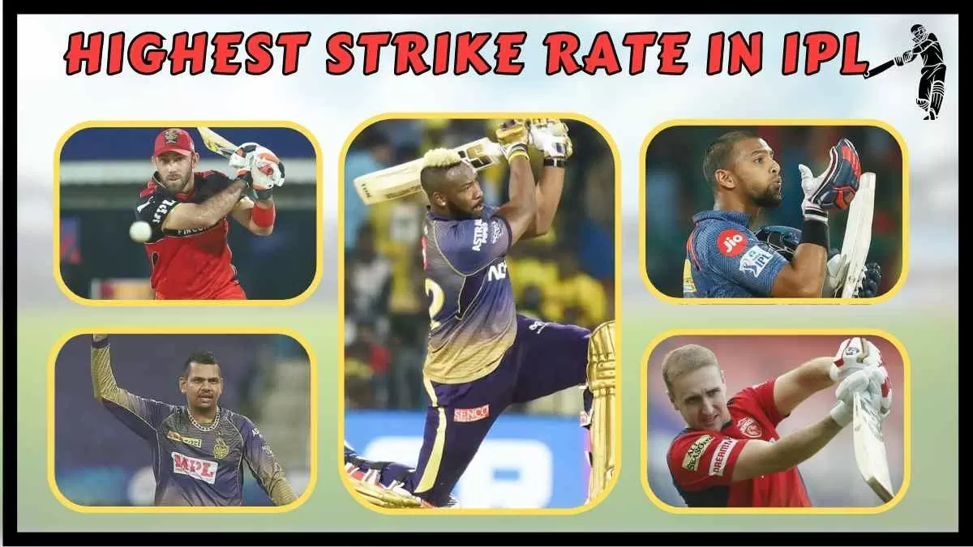
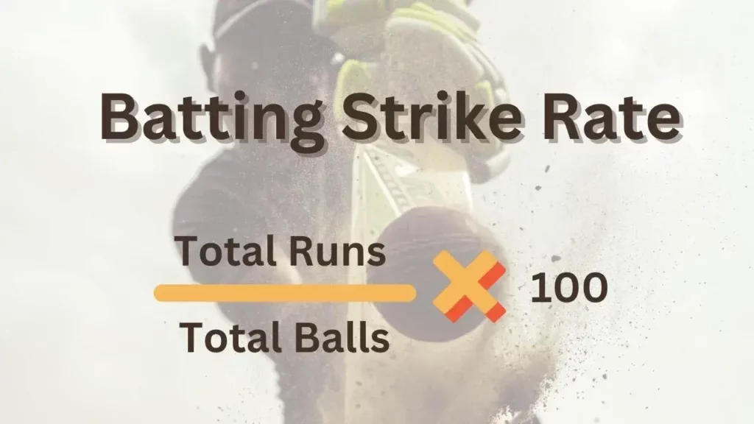

HIGHEST BATTING STRIKE RATE

Slide 7
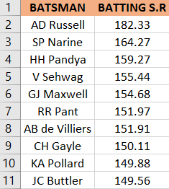
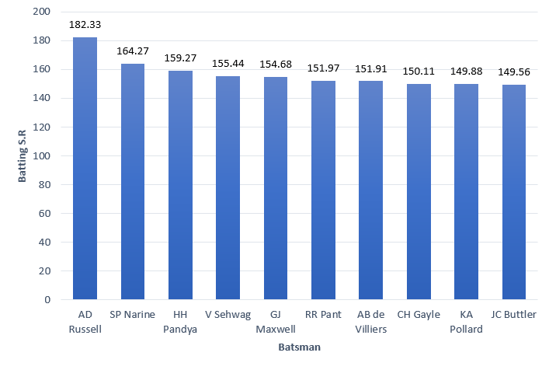
List of 10 batsman with high batting strike rate who have faced at least 500 balls
SELECT
batsman,
ROUND((SUM(batsman_runs)*1.0 / COUNT(ball)) * 100,2) AS batsman_sr
FROM ipl_ball
WHERE
extras_type not in ('wides')
GROUP BY batsman
HAVING COUNT(ball) > 500
ORDER BY Batsman_sr DESC
LIMIT 10;

Slide 8
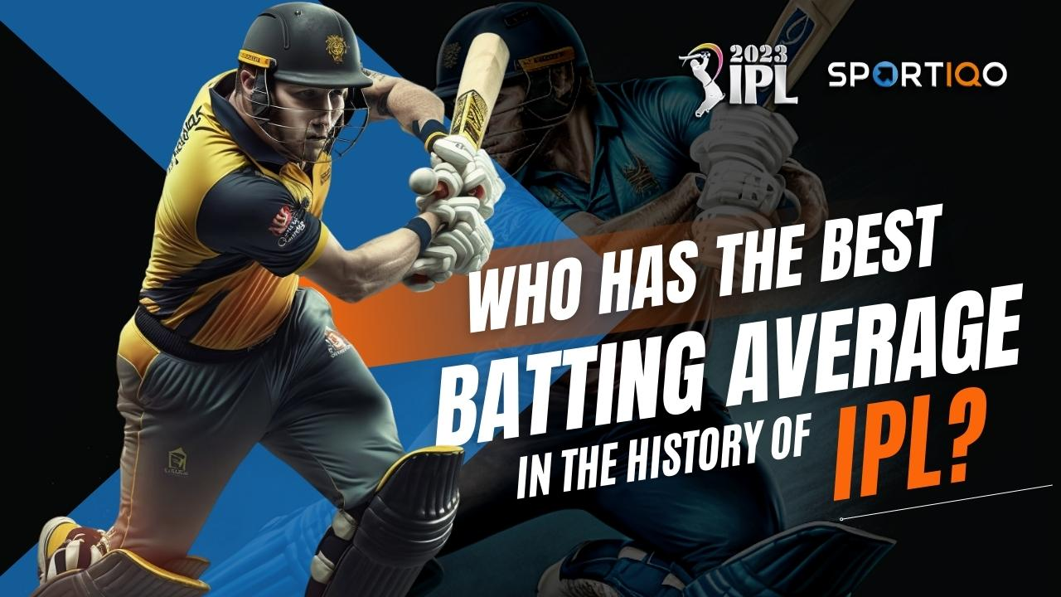
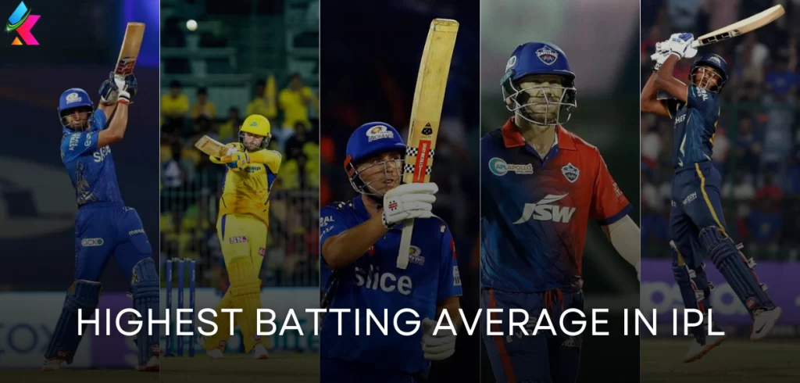
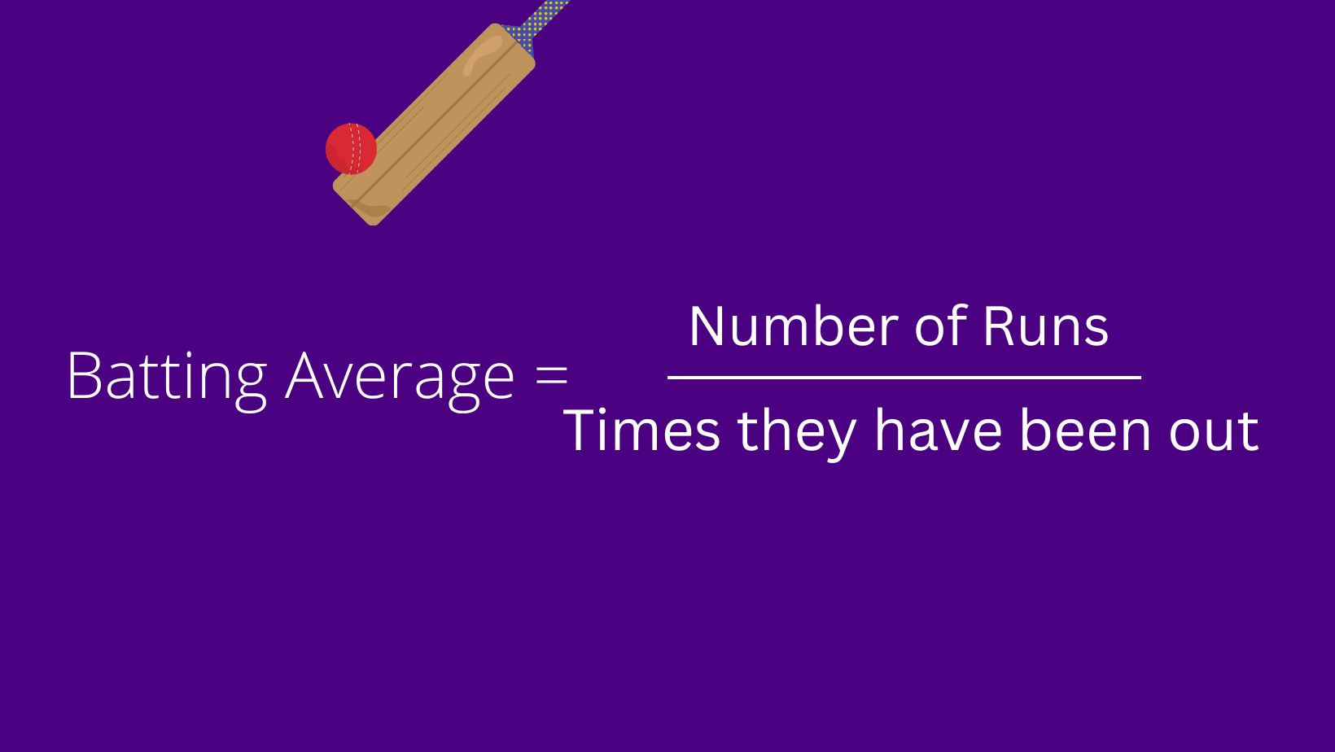
BEST BATTING AVERAGE

Slide 9
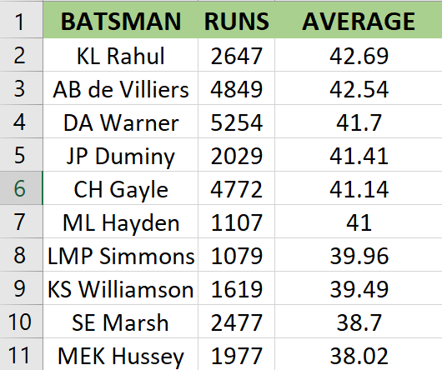

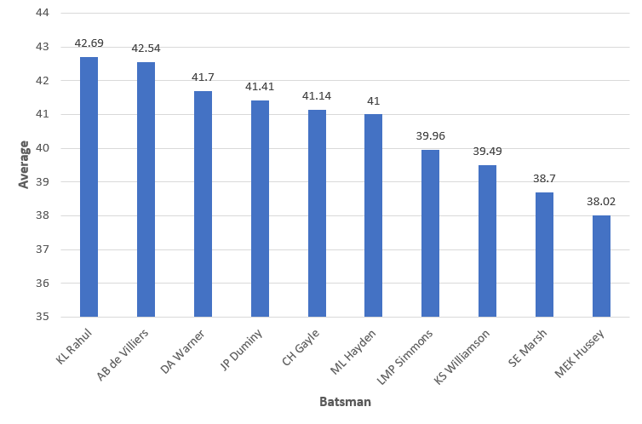
List of 10 players with best average who have played more than 2 IPL seasons (or 28 matches)
SELECT
Batsman,
SUM(batsman_runs) AS Runs,
ROUND(SUM(batsman_runs)*1.0/SUM(is_wicket),2) AS Average
FROM ipl_ball
GROUP BY Batsman
HAVING SUM(is_wicket) > 0
AND COUNT(DISTINCT id) > 28
ORDER BY average DESC
LIMIT 10;

Slide 10

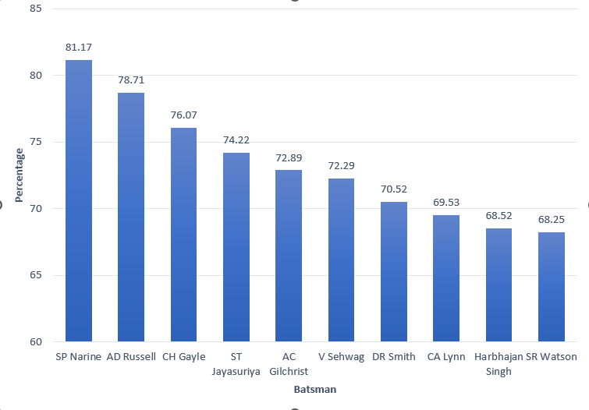
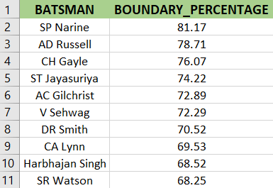
List of 10 players who have scored most runs in boundaries and have played more than 2 IPL seasons(more than 28 matches).
SELECT batsman,
ROUND(SUM(CASE WHEN batsman_runs in(4,6) THEN batsman_runs else 0 END)*1.0 / SUM(batsman_runs)*100,2) AS Boundary_Percentage
FROM ipl_ball
WHERE extras_type NOT IN ('wides')
GROUP BY Batsman
HAVING COUNT(DISTINCT id) > 28
ORDER BY boundary_percentage DESC
LIMIT 10;

Slide 11
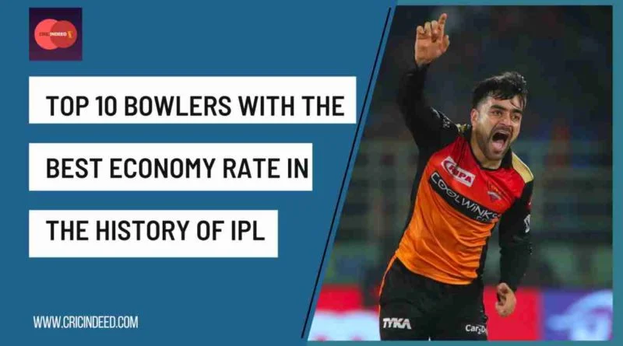
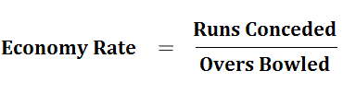

Bowlers with good economy

Slide 12

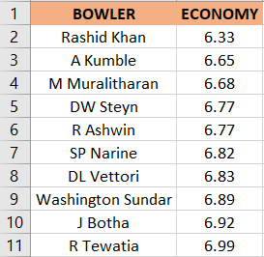
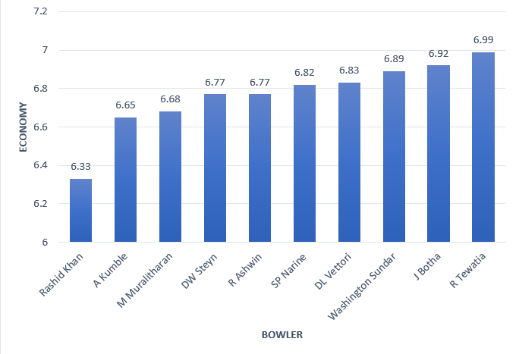
List of 10 bowlers with best economy who have bowled at least 500 balls in IPL
SELECT
bowler,
ROUND(SUM(total_runs)/(COUNT(bowler)/6.0), 2) as Economy
FROM ipl_ball
GROUP BY Bowler
HAVING
COUNT(bowler) > 500
ORDER BY Economy
LIMIT 10;

Slide 13
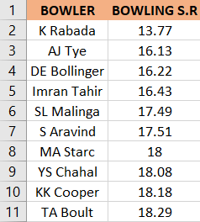
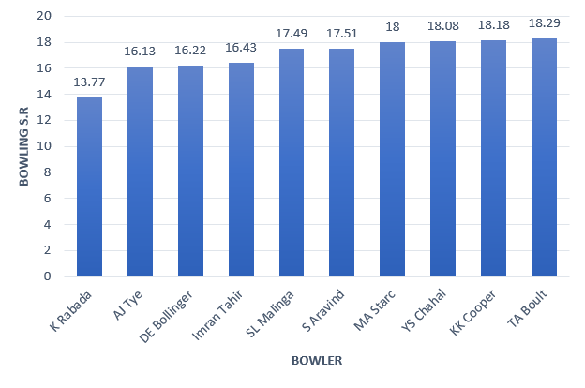
List of 10 bowlers who have the best strike rate and who gave bowled at least 500 balls
WITH ValidDismissals AS (
SELECT Bowler,is_wicket,
CASE
WHEN dismissal_kind IN ('bowled', 'caught', 'caught and bowled', 'hit wicket', 'lbw', 'stumped')
THEN 1
ELSE 0
END AS is_valid_dismissal
FROM ipl_ball)
SELECT
bowler,
ROUND(COUNT(bowler) * 1.0 / SUM(is_valid_dismissal),2)
AS economy
FROM ValidDismissals
GROUP BY bowler
HAVING
COUNT(bowler) > 500
ORDER BY economy
LIMIT 10;

Slide 14
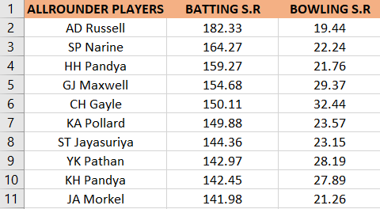
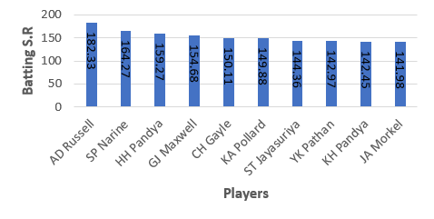
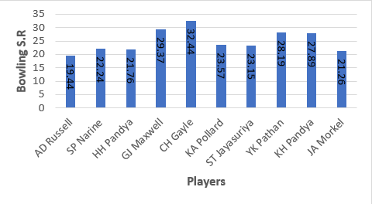
List of 10 allrounders who have the best bowling and batting strike rate and who gave faced at least 500 balls and bowled at least 300 balls.
SELECT
a.batsman AS all_rounder,
a.batsman_sr,
b.bowling_sr
FROM batting_sr a
INNER JOIN
bowling_sr b ON a.batsman = b.bowler
ORDER BY
a.batsman_sr DESC,
b.bowling_sr ASC
LIMIT 10;

Slide 15
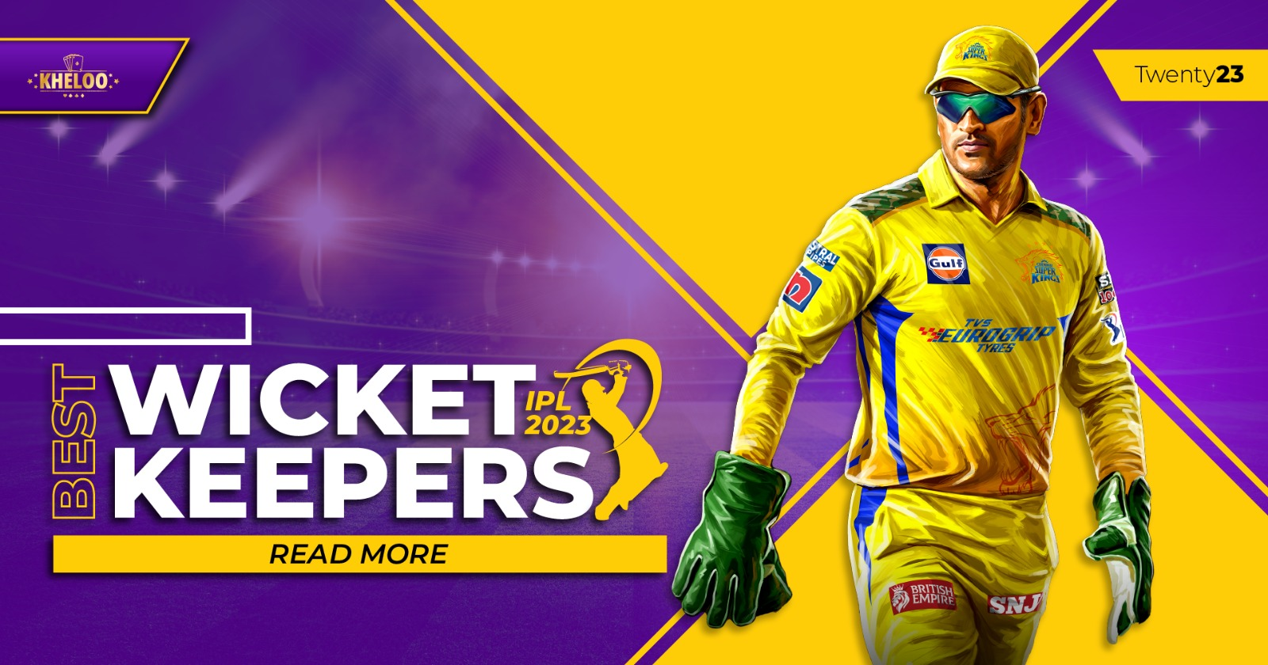


The most important criteria for selecting WICKETKEEPERS in the IPL.

Slide 16
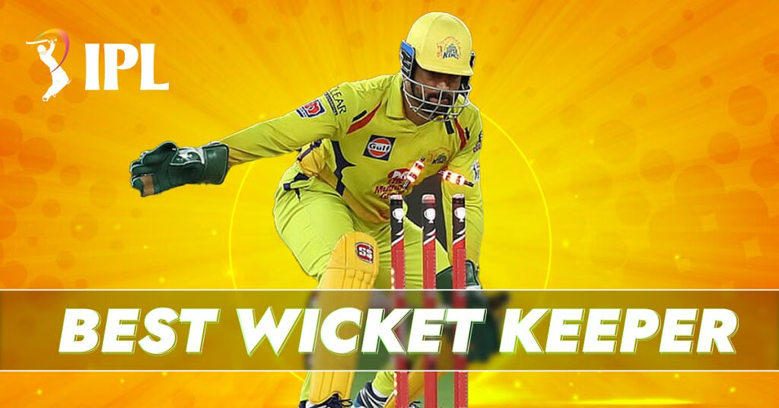
The most important criteria for selecting WICKET KEEPERS in the IPL.
Batting Ability: Prioritize wicketkeepers who can score quickly and hit boundaries, contributing to the team's run total.
Agility and Glovework: Strong wicketkeeping skills are vital. Look for wicketkeepers with quick reflexes, clean catching ability, and accurate stumpings.
Experience: Consider wicketkeepers with T20 experience who can handle pressure situations effectively.
Versatility: Choose wicketkeepers who can adapt to different match scenarios and contribute effectively in various batting positions.
Leadership and Communication: Wicketkeepers who can lead the fielding unit and effectively communicate with bowlers and fielders are valuable.
Fielding: Prioritize wicketkeepers with excellent fielding skills, capable of creating run-out opportunities.
Consistency: Look for wicketkeepers with a consistent track record, both in batting and wicketkeeping, to ensure stable performance throughout the tournament.

Slide 17

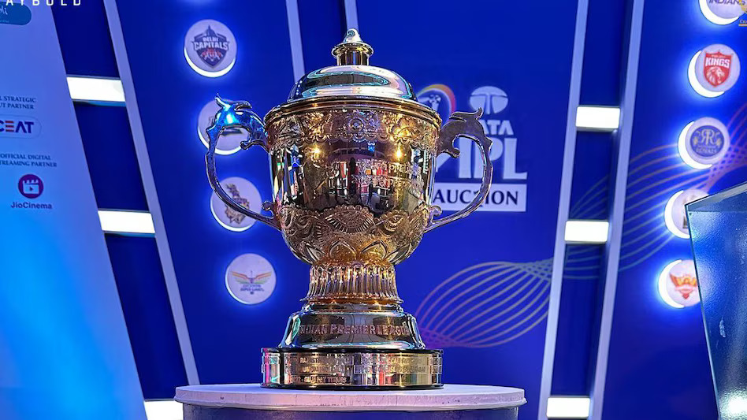
Additional Questions

Slide 18
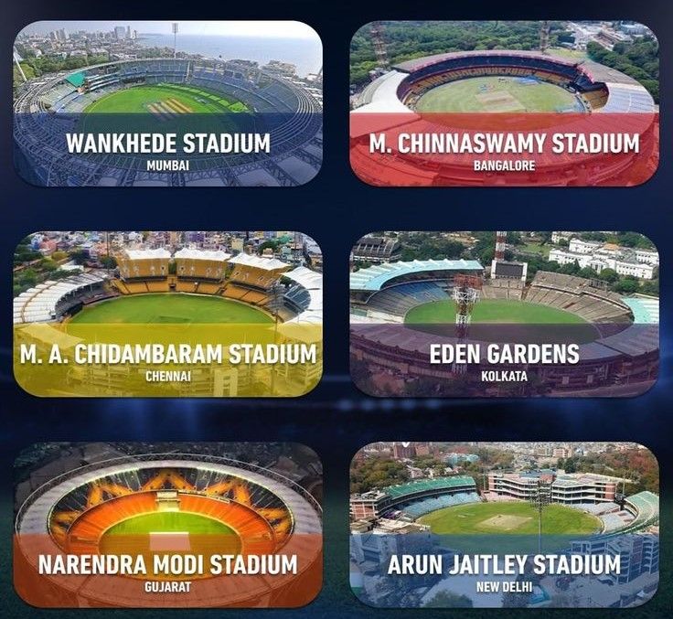
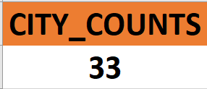
1. Get the count of cities that have hosted an IPL match.
SELECT
COUNT(DISTINCT city) AS City_Counts
FROM Matches
WHERE city IS NOT NULL;

Slide 19
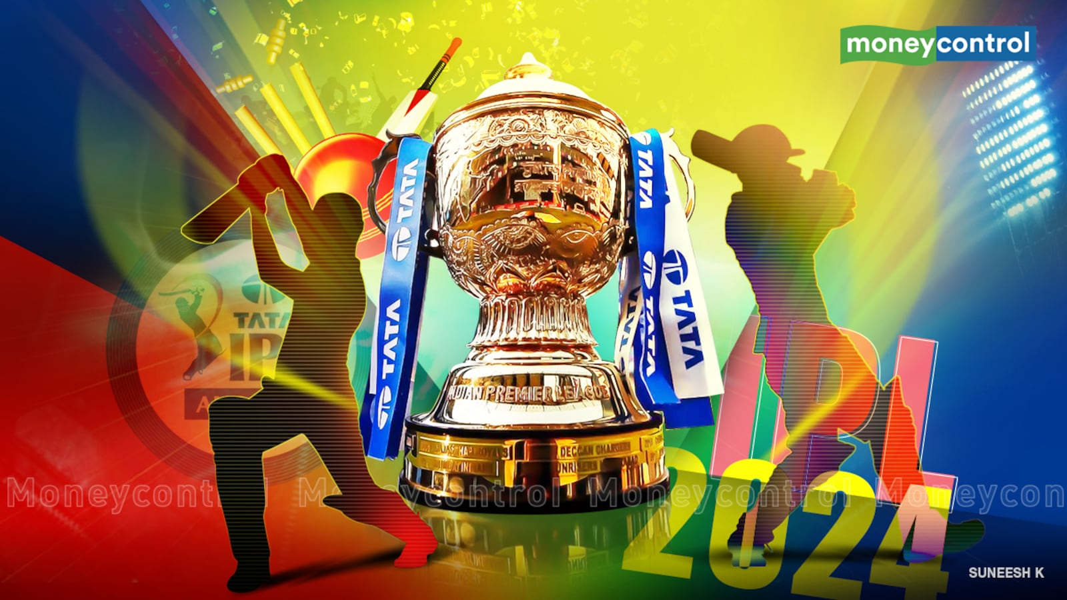
2. Create table deliveries_v02 with all the columns of the table ‘deliveries’ and an additional column ball_result containing values boundary, dot or other depending on the total_run (boundary for >= 4, dot for 0 and other for any other number)
CREATE TABLE deliveries_v02 AS
SELECT *,
CASE
WHEN total_runs >= 4 THEN 'boundary’
WHEN total_runs = 0 THEN 'dot’
ELSE 'other’
END AS ball_result
FROM ipl_ball;

Slide 20

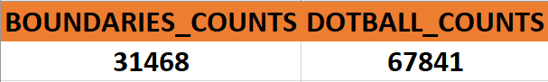
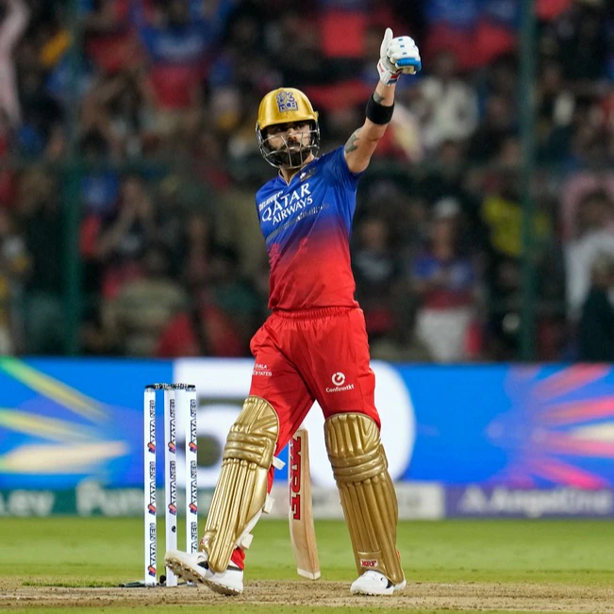
3. Write a query to fetch the total number of boundaries and dot balls from the deliveries_v02 table.
SELECT
SUM(CASE
WHEN (batsman_runs = 4 OR batsman_runs = 6) THEN 1
ELSE 0
END) AS BOUNDARIES_COUNT
SUM(CASE
WHEN total_runs = 0 THEN 1
ELSE 0
END) AS DOTBALL_COUNTS
FROM deliveries_v02;

Slide 21

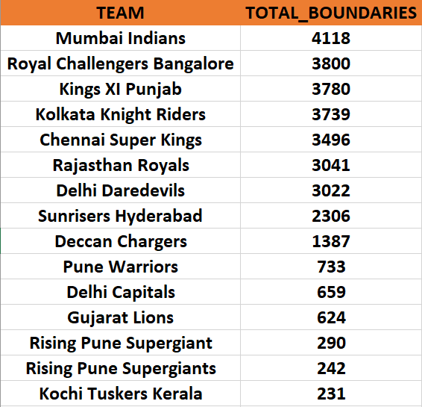
4. Write a query to fetch the total number of boundaries scored by each team from the deliveries_v02 table and order it in descending order of the number of boundaries scored.
SELECT
Team,
COUNT(CASE
WHEN batsman_runs = 4 OR batsman_runs = 6 THEN 1
END) AS TOTAL_BOUNDARIES
FROM
deliveries_v02
GROUP BY
Team
ORDER BY
TOTAL_BOUNDARIES DESC;

Slide 22


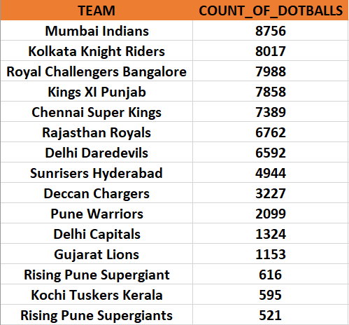
5. Write a query to fetch the total number of dot balls bowled by each team and order it in descending order of the total number of dot balls bowled.
SELECT
TEAM,
COUNT(CASE
WHEN total_runs = 0 THEN 1
END) AS Count_of_Dotballs
FROM
deliveries_v02
GROUP BY
TEAM
ORDER BY
Count_of_Dotballs DESC;

Slide 23
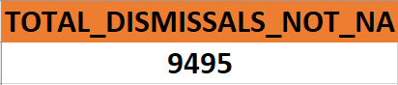
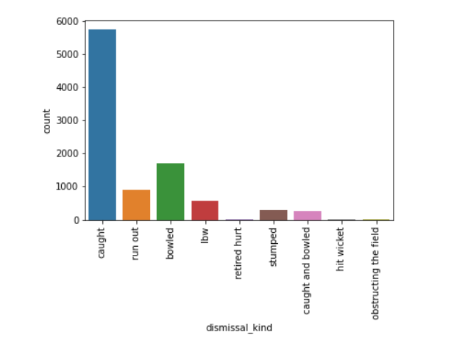
6. Write a query to fetch the total number of dismissals by dismissal kinds where dismissal kind is not NA.
SELECT
dismissal_kind,
COUNT(*) AS Total_Dismissals_Not_NA
FROM
deliveries_v02
WHERE
dismissal_kind IS NOT NULL
AND dismissal_kind != 'NA'
GROUP BY
dismissal_kind
ORDER BY
Total_Dismissals_Not_NA DESC;

Slide 24


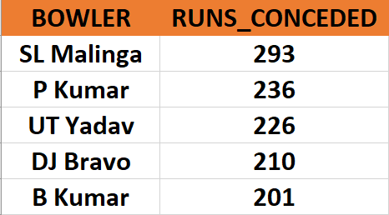
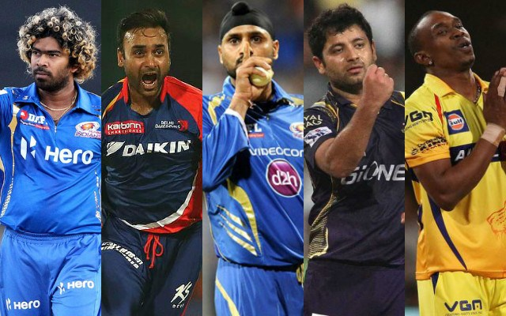
7. Write a query to get the top 5 bowlers who conceded maximum extra runs from the deliveries table.
SELECT
Bowler,
SUM(extra_runs) AS Runs_Conceded
FROM
deliveries
GROUP BY
Bowler
ORDER BY
Runs_Conceded DESC
LIMIT 5;

Slide 25
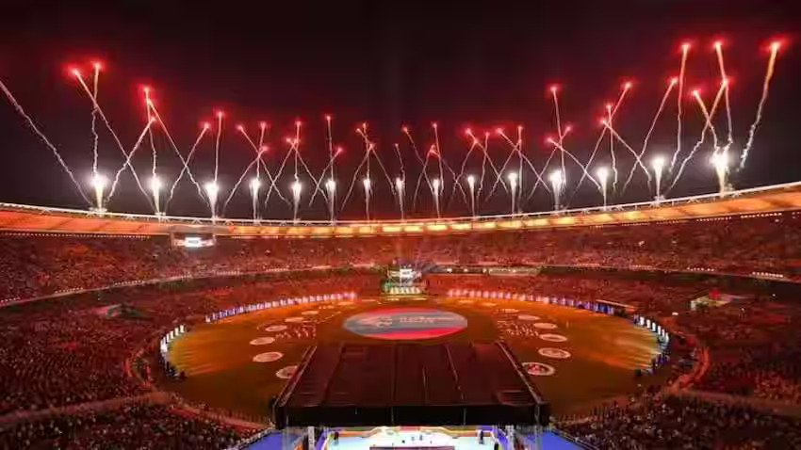

8. Write a query to create a table named deliveries_v03 with all the columns of deliveries_v02 table and two additional column (named venue and match_date) of venue and date from table matches.
CREATE TABLE deliveries_v03 AS
SELECT
d.*,
m.venue,
EXTRACT(DAY FROM m.date) AS Match_Date
FROM deliveries_v02 d
LEFT JOIN
IPL_Match m ON d.id = m.id;

Slide 26
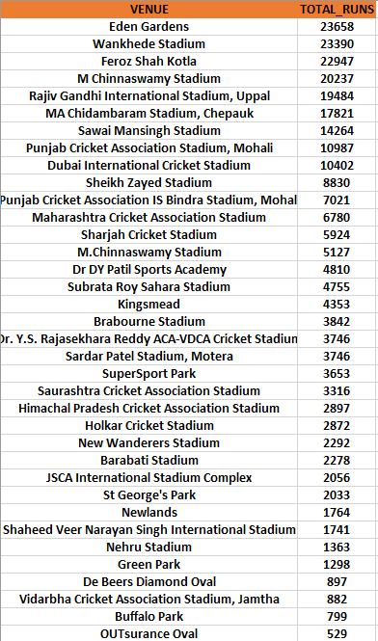
9. Write a query to fetch the total runs scored for each venue and order it in the descending order of total runs scored.
SELECT
Venue,
SUM(total_runs) AS Total_Runs
FROM
matches m
JOIN
deliveries d ON m.match_id = d.match_id
GROUP BY
Venue
ORDER BY
Total_Runs DESC;

Slide 27
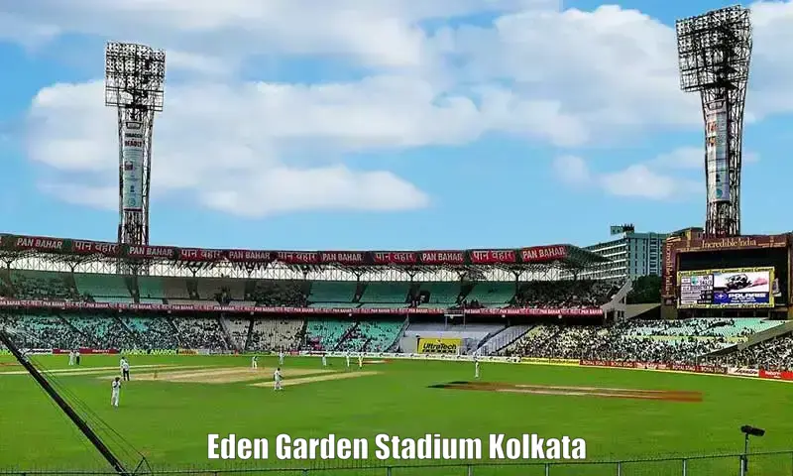
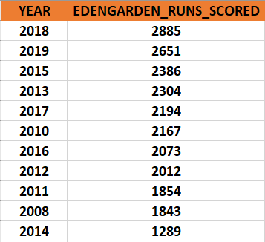
10. Write a query to fetch the year-wise total runs scored at Eden Gardens and order it in the descending order of total runs scored.
SELECT
YEAR(m.date) AS Year,
SUM(d.total_runs) AS total_runs_scored
FROM
matches m
JOIN
deliveries d ON m.match_id = d.match_id
WHERE
m.venue = 'Eden Gardens'
GROUP BY
YEAR(m.date)
ORDER BY
EdenGarden_Runs_Scored DESC;

